Slide 1

NYC TLC Taxi Trip Data Analysis - Tipping Behavior
by Hans Darmawan
JCDS2602

Slide 2

OVERVIEW
BACKGROUND
GAP ANALYSIS
PROBLEM STATEMENT
SCOPE OF WORK
DATA UNDERSTANDING
DATA WRANGLING
EXPLORATORY DATA ANALYSIS

Slide 3

Taxi transportation is essential for urban mobility, offering convenience and accessibility
NYC TLC regulates taxis and for-hire vehicles in New York City since 1937
Competition between traditional taxis and ride-sharing services has increased significantly
Tipping behavior significantly influences taxi driver earnings
BACKGROUND

Slide 4

GAP ANALYSIS
Ride-sharing apps have integrated structured tipping systems that prompt passengers
Traditional taxi tipping is less standardized with inconsistent behavior patterns
Lack of structured data collection makes it difficult to identify tipping patterns in taxis
NYC TLC needs deeper understanding of taxi tipping behavior to improve service quality

Slide 5

PROBLEM STATEMENT
Lack of clarity regarding factors influencing tip amounts in NYC taxis
Need to examine relationships between trip characteristics and tipping behavior
Understanding these relationships will help NYC TLC develop effective regulations
Findings can inform driver training to improve customer service and increase tips

Slide 6

SCOPE OF WORK
Data collection from NYC TLC trip dataset, Taxi Zones CSV, and GeoJSON files
Data wrangling to clean and prepare dataset for analysis
Exploratory Data Analysis to identify patterns in tipping behavior
Analysis of tipping patterns by time, payment method, location, and trip characteristics

Slide 7
Dataset contains taxi trip information including pickup/dropoff times, locations, fares
Key fields include vendor ID, pickup/dropoff datetime, location IDs, passenger count
Data includes fare amount, tip amount, and various surcharges
Dataset covers January 2023 with over 68,000 initial records
DATA UNDERSTANDING

Slide 8

EDA: KEY FINDINGS
Tipping patterns vary significantly by day of week and hour of day
Credit card payments receive substantially higher tips than cash payments
Pickup and dropoff boroughs influence tipping behavior
Weak positive correlation between trip distance/duration and tip amounts

Slide 9
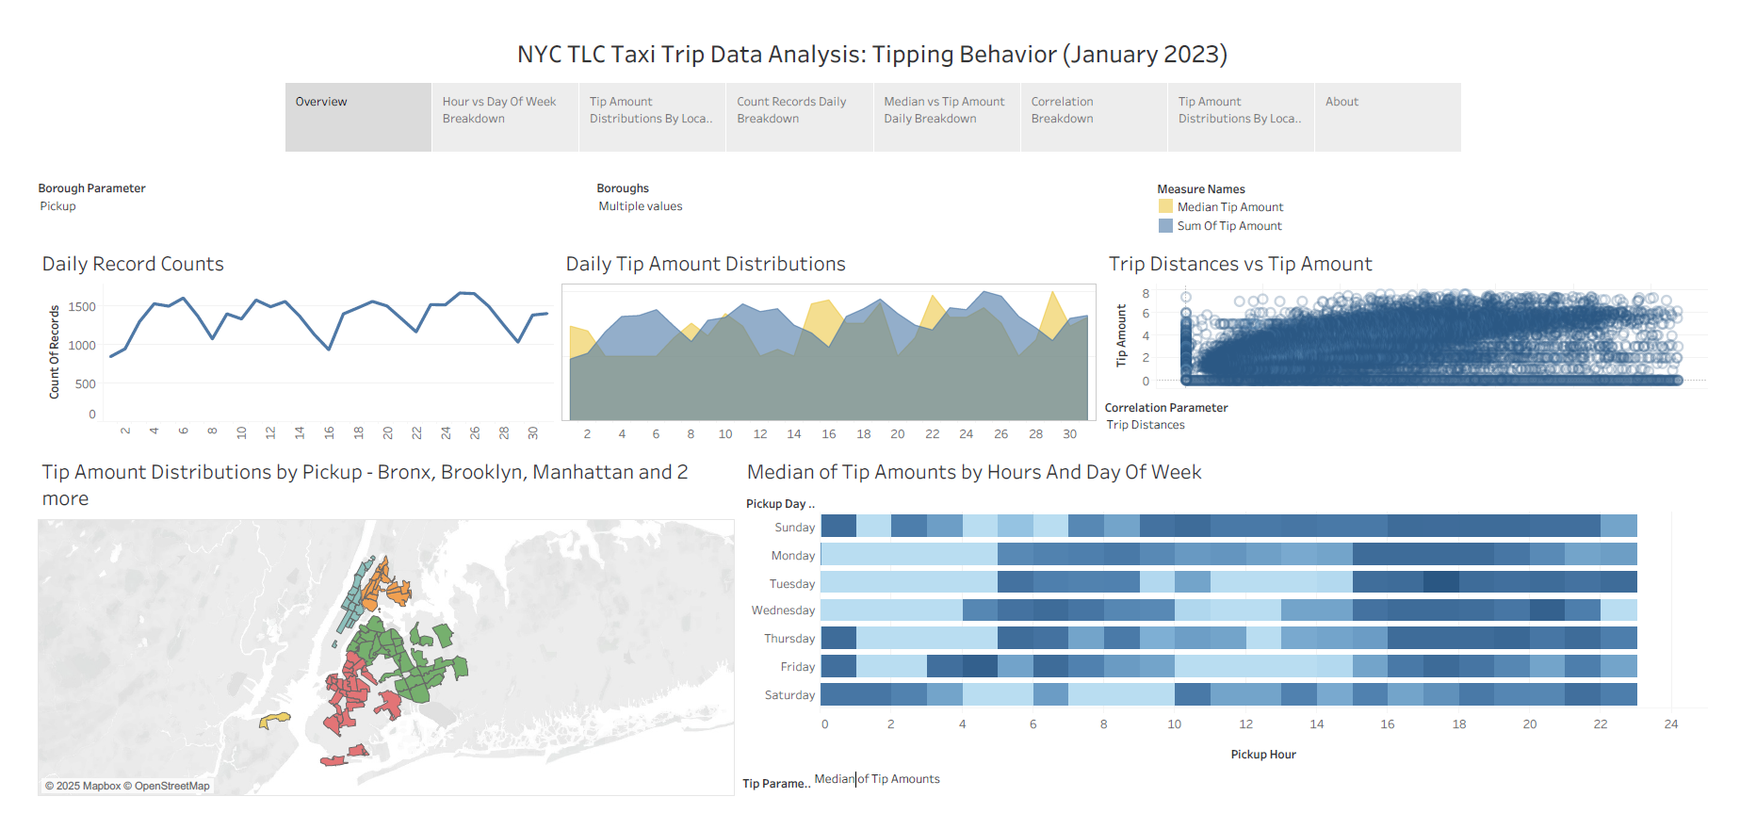

Slide 10
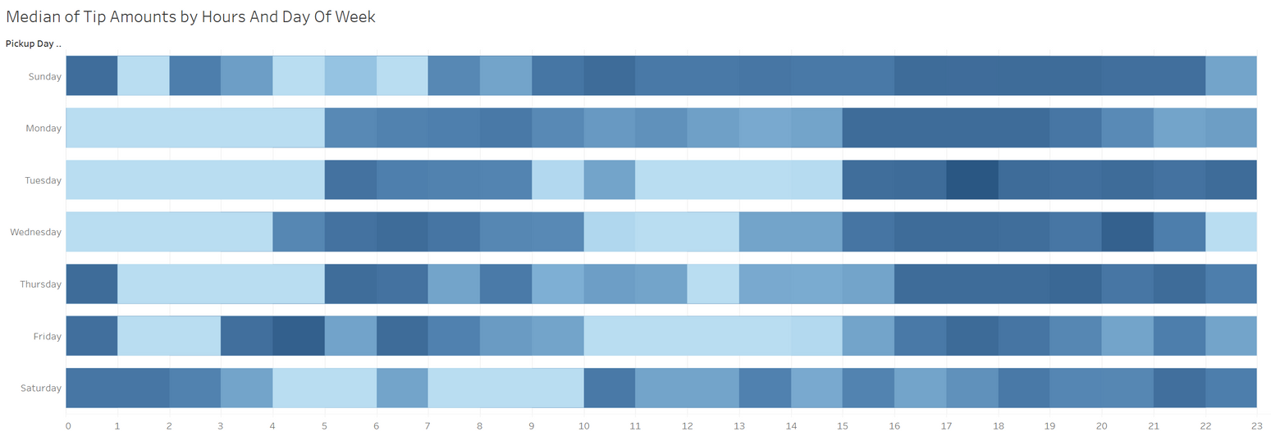
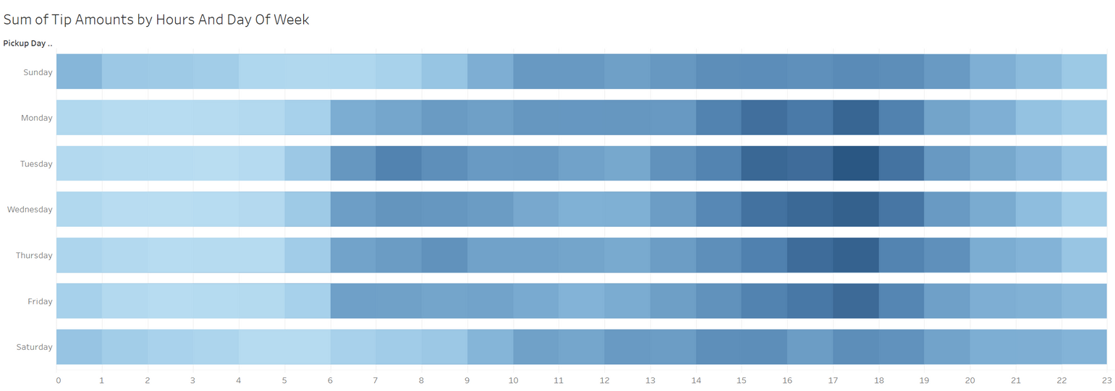

Slide 11
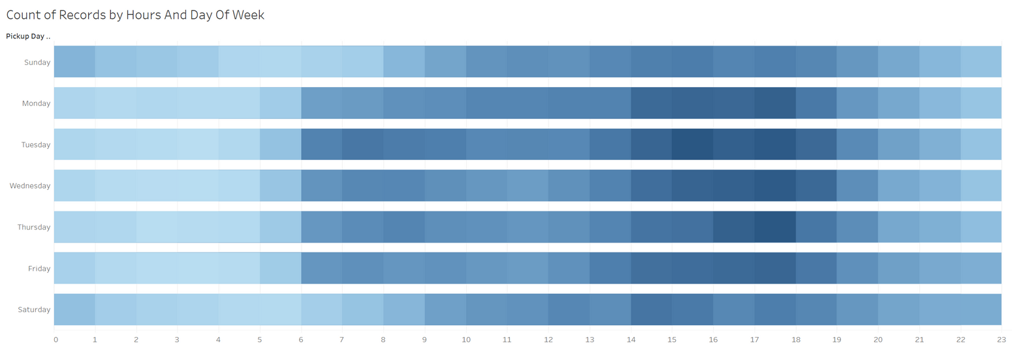
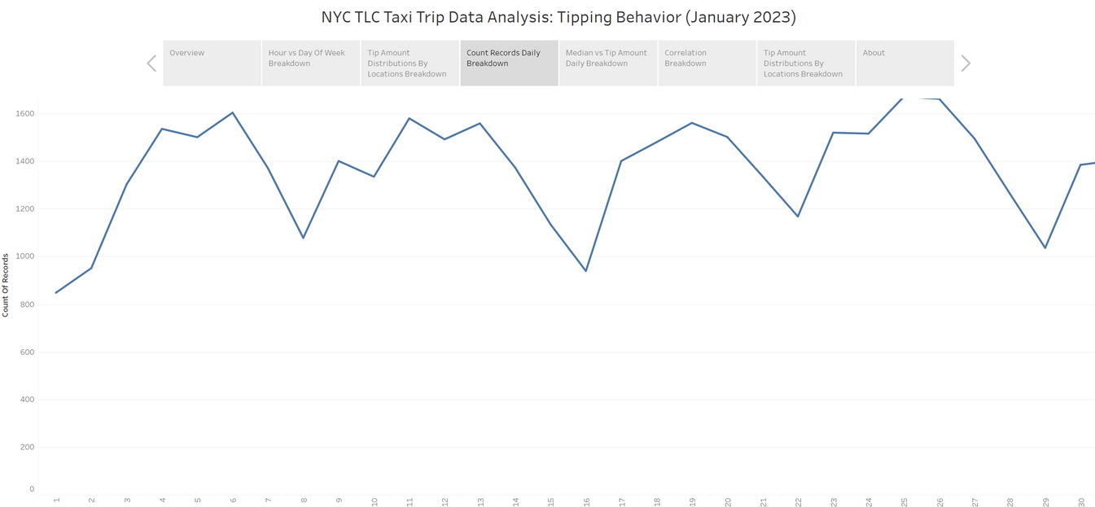

Slide 12
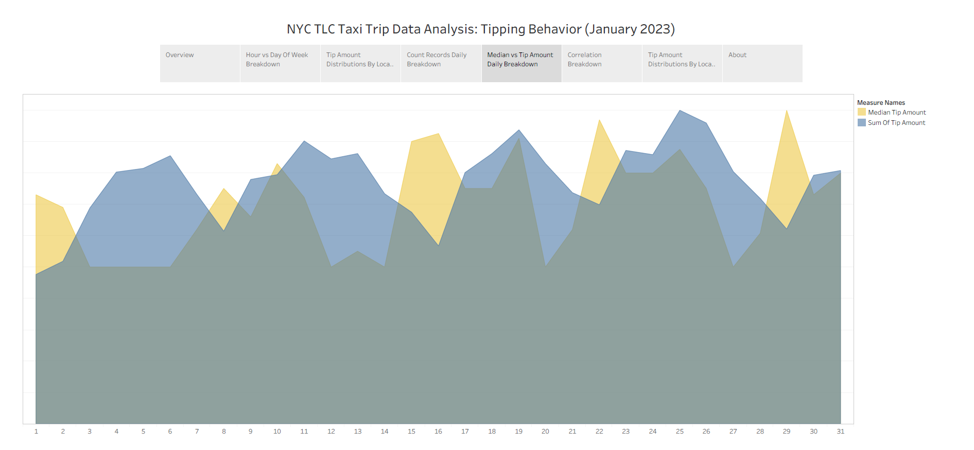

Slide 13
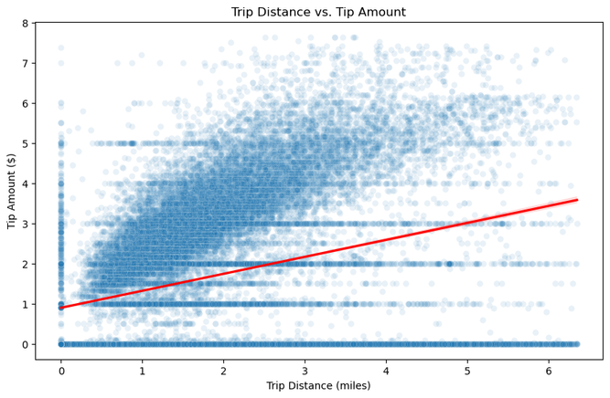
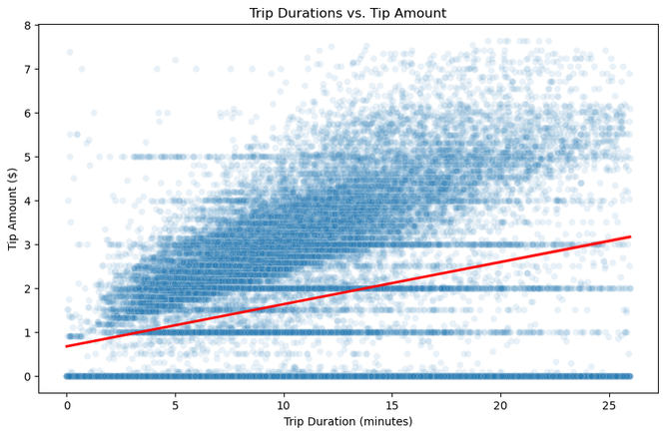
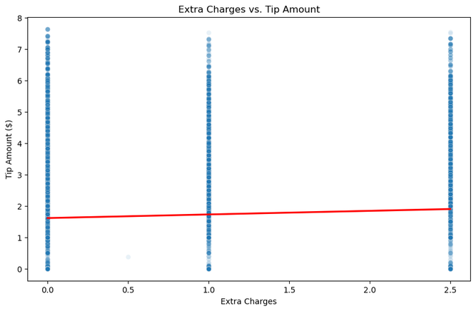
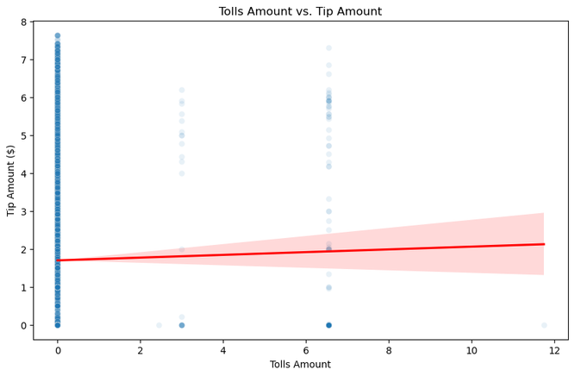
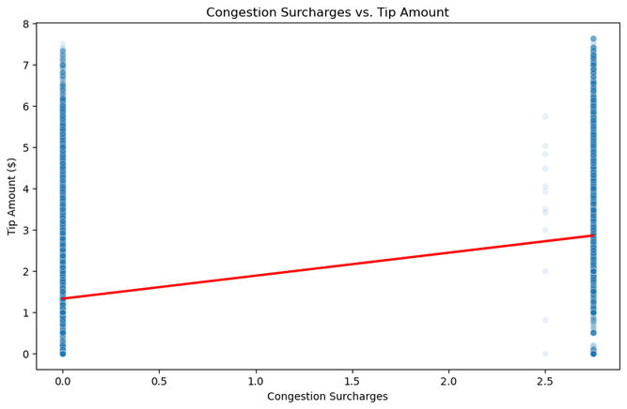
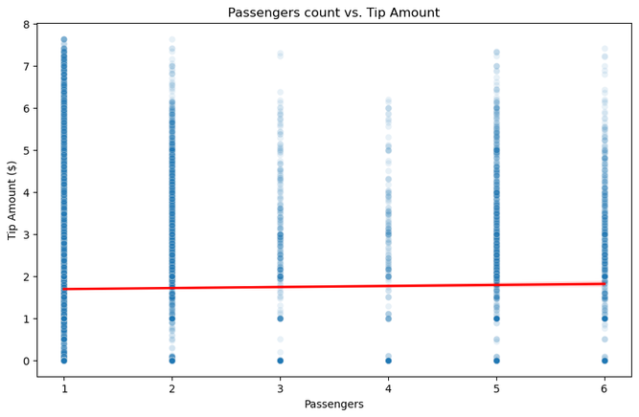

Slide 14
CONCLUSIONS
Payment method is the strongest predictor of tipping behavior
Temporal and geographic factors significantly influence tipping patterns
Recommendations include promoting cashless payments and focusing on high-tip zones
Driver training should emphasize service quality during peak tipping periods

Slide 15

Thank You
Any Questions ?

